Slide 1




ADD COMPANY NAME
Condition Based Maintenance of T-72 Army Tanks
Write company name here
Information available in audio.

Slide 2

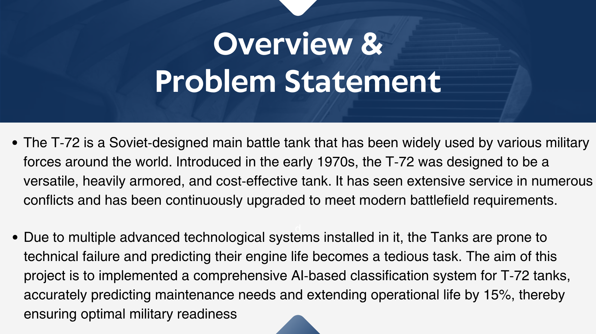

Slide 3
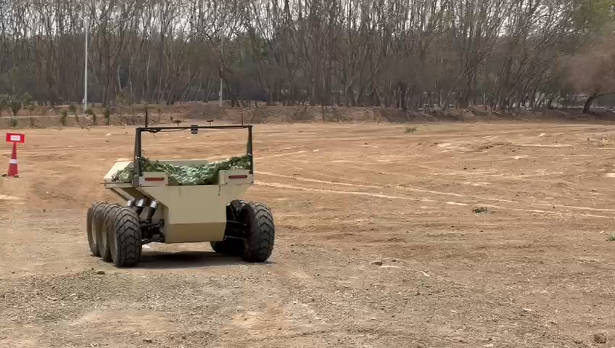
Edgeforce Solutions
An AI-based, Defense Startup aimed at providing IT Solutions for the betterment of Army, Navy & Air Force regiments of India.
Their core competency lies in Edge Computing, Computer Vision, Deep Learning, Autonomus Engines, Sensor Technology & many more…
Drag and drop your photo or video! Click the sample photo or video and delete. Select yours from the uploads tab, drag, and then drop inside the frame!
Back to Agenda

Slide 4

Input Features
Target Feature
Coolant Temperature
Engine Bands from 0-9
Band 0 indicating 0-100 hours of Engine Life done, hence a serviced tank.
Band 1 indicating 100-200 hours of Engine Life done
.
.
.
Band 9 indicating 900-1000 hours of Engine Life done, hence requiring immediate servicing & maintenance
Oil TDN (Total Dissolved Nitrogen), Oil Temperature & Oil Pressure
Different types of Vibrations in 4-dimensional spaces
Total RMS Velocity

Slide 5
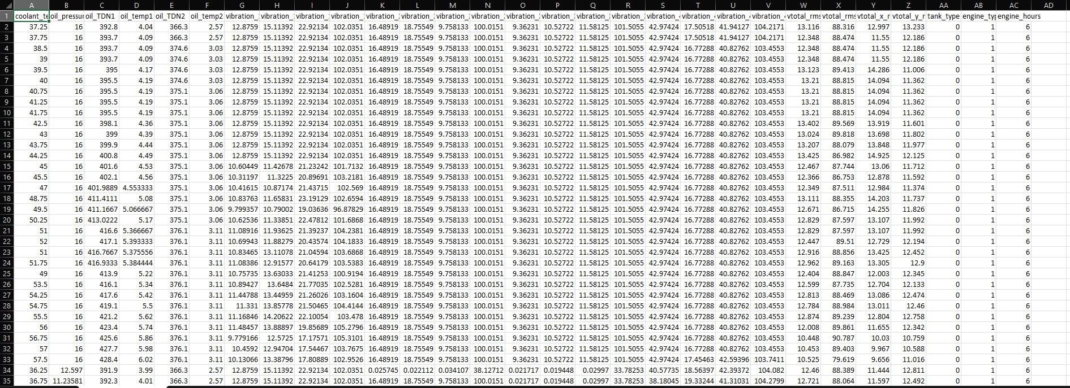
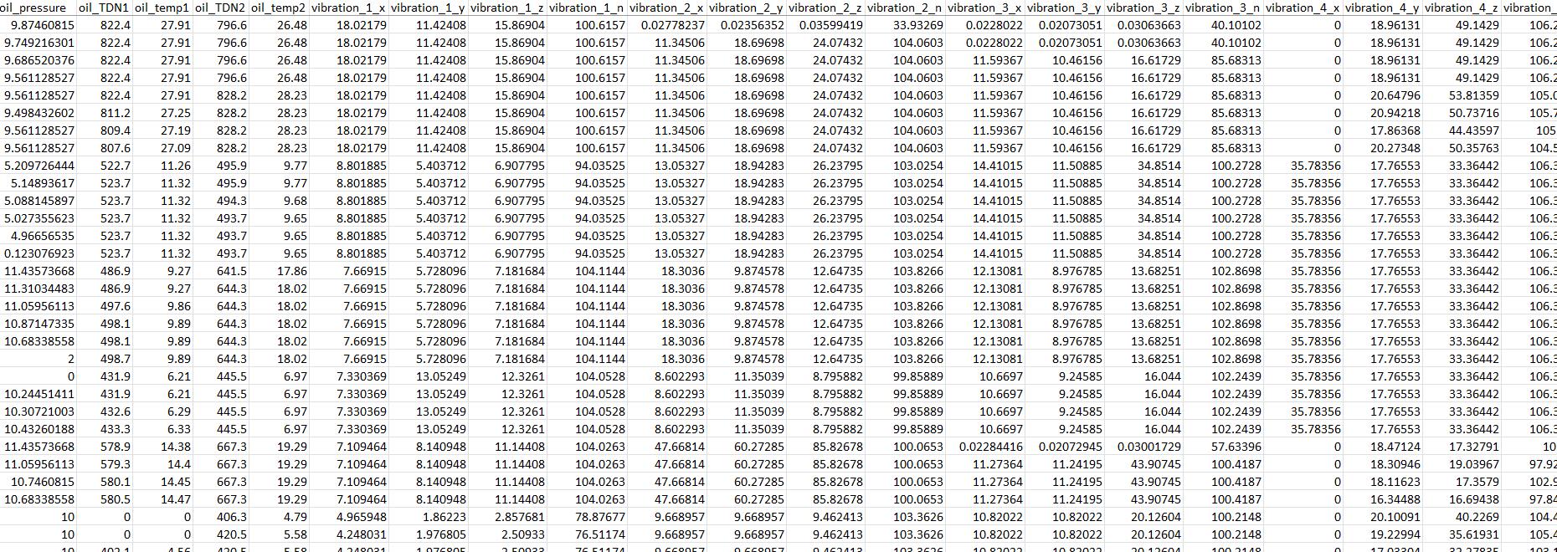
Data Collection
Mission
Write the company's mission statement here.
Briefly elaborate on what you want to discuss.
Vision
Write the company's vision
statement here.
Raw and Unprocessed Data were collected by Military offcials, from the various sensors installed in the Tanks to monitor the life regularly and were sent to us in CSV format.
As, seen from the above image, there are multiple instances of missing values in the dataset, which could have arrived from the faulty sensors or sudden power outage while collection of data. These missing values can hamper the AI model to a great extent.

Slide 6





Handling the Missing Values
Feature
Engineering
In total there were around 300 missing data values in the dataset from Oil TDN, Oil Temp. & Vibration. We utilised KNN Imputer, which is based on calculating the euclidean distance from missing value to ‘K’ data points & imputing the value of the nearest point.
Feature Scaling
The values for the Oil temp. were in the range of 3 deg. To 27 deg., Oil TDN(Total Dissolved Nitrogen) from 380 to 820 & vibrations in the range of 5 to 450. Before proceeding for model development, we have to scale this data and bring them in a uniform scale. We implemented MinMax Scaler from sklearn library for this issue and scaled our dataset.
Back to Agenda

Slide 7
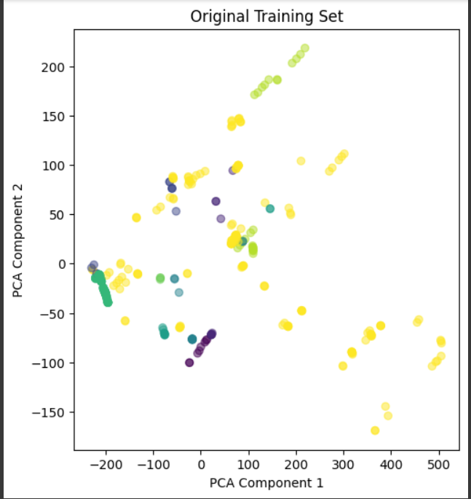
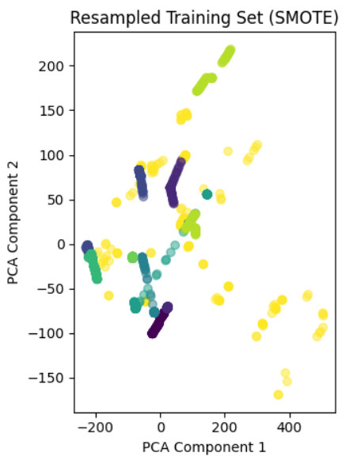
SMOTE (Synthetic Minority Oversampling)
After thorough observation of data points, we found that the Band-9 i.e. engine hours from 900-1000, had the most no. of datapoints in it, i.e. majority of the Tanks were required immediate maintenance and only 8 datapoints in Band-0, i.e. newly renovated tanks.
This issue can cause the model to be BIASED towards the majority class and our model may not provide accurate prediction for the tanks in the minority class. To address this issue, we performed SMOTE on the minority class to increase their instances, so that the model remains unbiased.

Slide 8
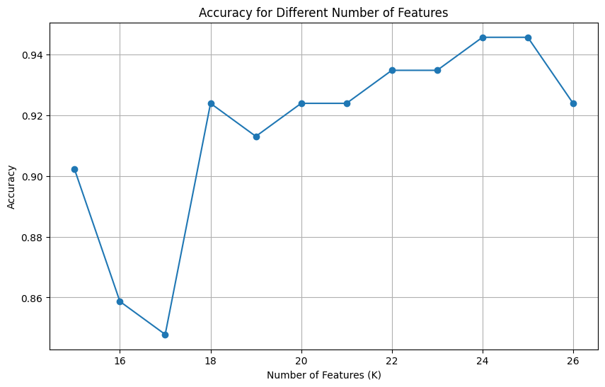
We had to choose from over 26 Features of the data, on which to apply our model. For very large volumes of data involving multiple features (> 100), we need high Computational Power for better accuracy.
Feature Selection becomes an important step for choosing only the input features that are highly correlated to the target feature. ANOVA technique for feature selection of numerical columns performed the best giving an impressive accuracy of 92.4%
Add even more sub-ideas
Add more sub-ideas
Add more sub-ideas
Add even more sub-ideas
Add a related idea
Add a
main topic
Add a related idea
Add a related idea
Add even more sub-ideas
Add a related idea
Feature Selecting using ANOVA
Add more sub-ideas
Add even more sub-ideas
Add more sub-ideas

Slide 9
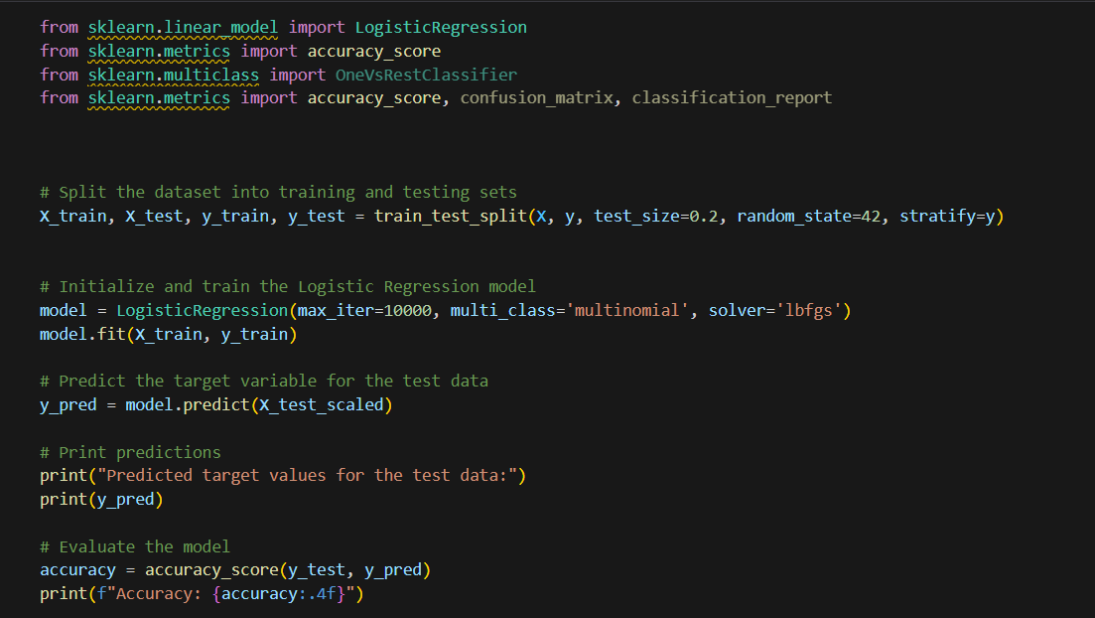
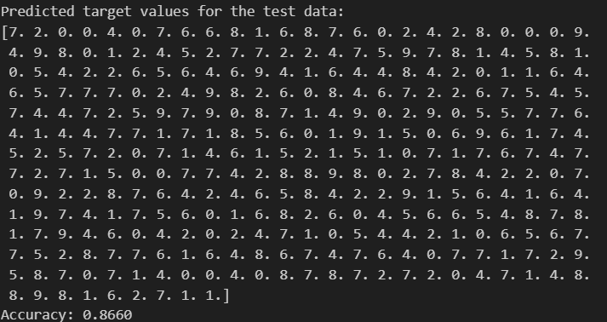
Model Training & Evaluation
After comparing various machine learning classification models, Support Vector Classifier(SVC), Random Forest Classifier, Categorical Cross Entropy & XGBoost, Logistic Regression Model gave the best result with attaining an accuracy of 86.6% which is an outstanding score for
B | for blur | C | C for confetti
D | for a drumroll | M | M for mic drop
O | for bubbles | Q | Q for quiet
U | for unveil | # | Any number from 0-9 for a timer

Slide 10
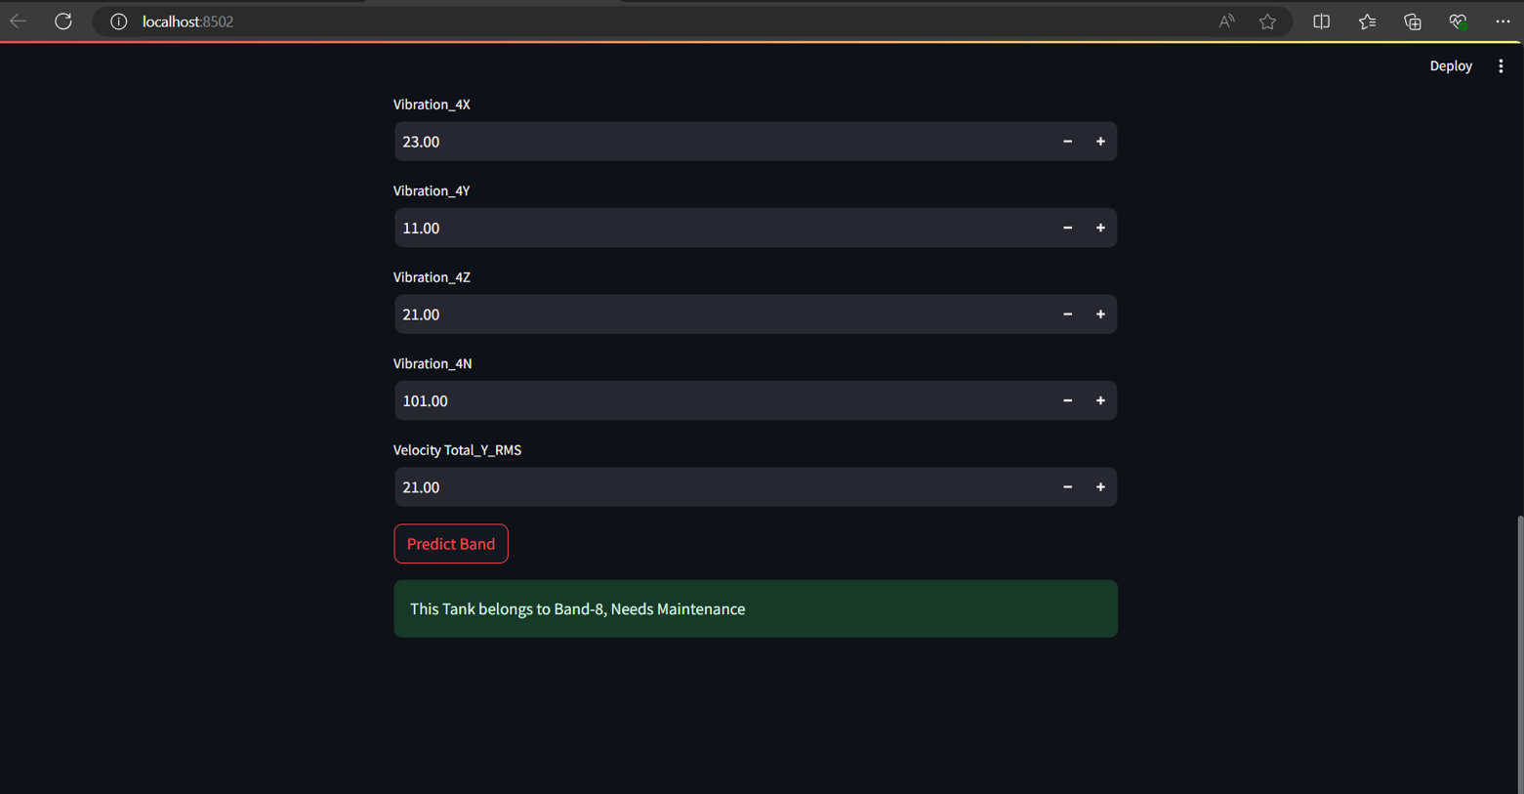






Model Deployment in Streamlit
Model Deployment in Streamlit
The classification model is deployed on a web server of streamlit, where after proper filling of column’s datapoints, the app will predict in which band the Tank comes & whether it needs immediate servicing or not.
The classification model is deployed on a web server of streamlit, where after proper filling of column’s datapoints, the app will in which band the Tank comes & whether it needs immediate servicing or not.

Slide 11
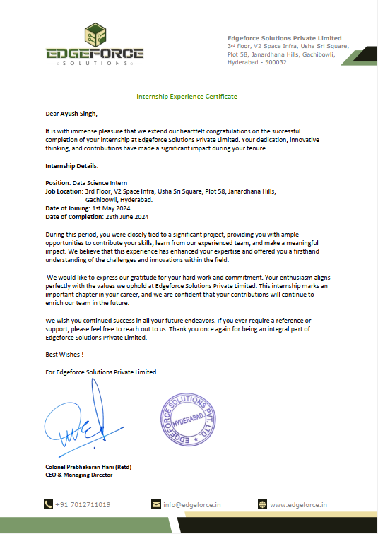
Internship
Completion
Certificate

